Slide 1
Evidence Based Practice 4
Summarising the findings

Slide 2
What have you found?
At the end of your search you should have all of the relevant papers currently available
Group the papers by research method
For example RCTs together
Assess papers for methodological quality
Discard those of poor quality?

Slide 3
Consider these questions:
Is the evidence relevant to me and my clients?
Are the participants similar to those you see? Age gender, baseline measures of severity etc.
Are the interventions and their application appropriate in my setting? What was the intervention? How was it applied?
Are the outcomes useful?
Are important outcomes (to your clients)included?
Are surrogate measures used?
What does this mean for me and my practice?
Does this confirm my thinking and practice?
Does this suggest new or different interventions?
Are there costs and risks associated with current or new interventions?

Slide 4
Take out your papers
Answer the questions:
Is the evidence relevant to me and my clients?
Are the participants similar to those you see?
Are the interventions and their application appropriate in my setting?
Are the outcomes useful?
Are important outcomes included?
Are surrogate measures used?
What does this mean for me and my practice?
Does this confirm my thinking and practice?
Does this suggest new or different interventions?
What are the costs and risks associated with current or new interventions?

Slide 5
Are the results consistent?
Often the results across studies are not consistent.
You need to think further to work out why and what do the results mean for your EBP.
Making a summary of each paper can help to highlight differences in sampling, measures and results.

Slide 6
Start to summarise the papers
Develop tables that allow you to compare the papers
You will have at least 2 tables, perhaps more
One table should record and compare methodology (this will usually have: authors, publication date, overarching method, participant selection, participant numbers, groups and randomisation procedure, what participants did, what was measured, when was it measured, independence of assessment and treatment, quality of the study).
One table will record and compare study findings (point measures and indicators of group variability at appropriate time frames, data analysis, appropriateness of analysis, study findings and conclusions).

Slide 7
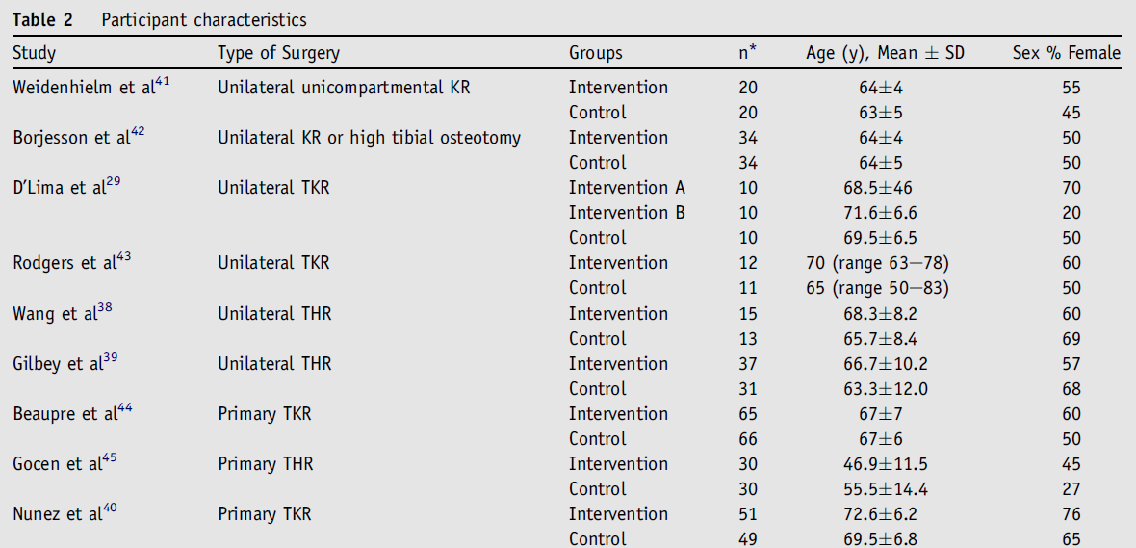
Example:
Gill S & McBurney H. Does exercise reduce pain and improve physical function before hip or knee replacement surgery? A systematic review and meta-analysis of randomised controlled trials. Archives of Physical Medicine and Rehabilitation 2013 94: 164-176.

Slide 8
What does this table indicate?
Not every one had a total hip or total knee replacement
Most of the studies had small numbers in each group
The population studied by Gocen et al were younger than all other studies
The study populations had quite different proportions of male and females

Slide 9
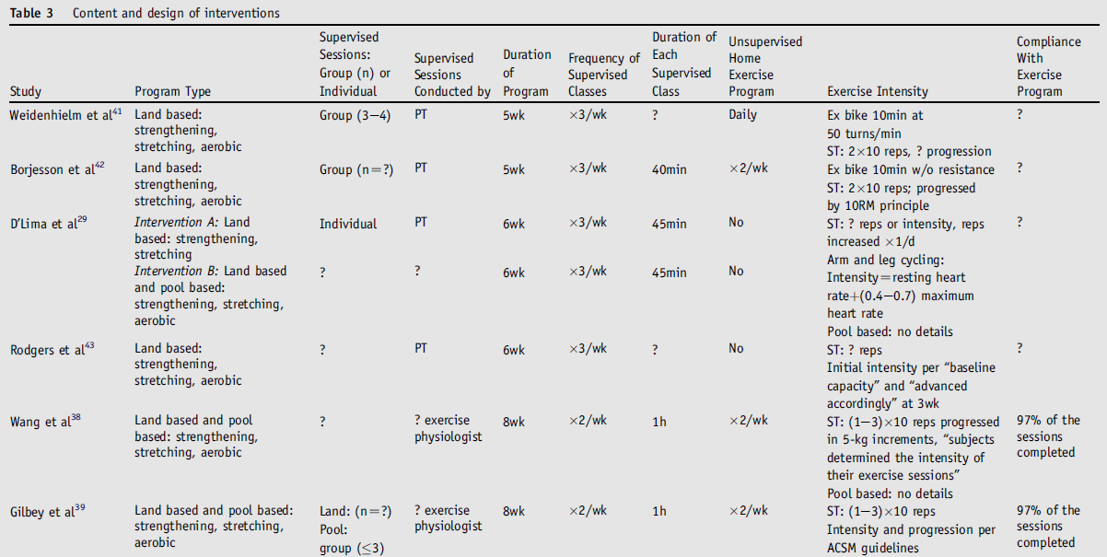
Comparing the interventions

Slide 10
What does this table indicate?
Interventions varied considerably
Most were land based
Most included aspects of stretching, strengthening and aerobic activity
Programs were group or individual
Programs went for between 5 and 8 weeks
Exercise was supervised 2 or 3 times per week
Duration of supervised sessions varied from 40-60 minutes
Home exercise requirements varied from none to daily
Exercise intensity and compliance were poorly recorded

Slide 11
Outcomes
Pain (reduction in pain)
10 KR studies, 612 participants
3 favour control, 7 favour exercise, only one is statistically significant – overall result favours exercise but not statistically significant
5 HR studies, 177 participants
All on the side of favouring treatment but none are statistically significant – overall result favours exercise and is statistically significant

Slide 12
What is a Forest Plot?
A forest plot is a diagram that summarises the findings of a number of randomised trials of intervention.
Each row on the plot corresponds to one trial
For each trial the estimate of the effect of the intervention is shown with lines to indicate the extent of the 95% confidence intervals
A large symbol at the bottom is the pooled estimate of the effect of the intervention (obtained by combining the effect of all of the studies weighted by their number of participants)

Slide 13
How do I make a forest plot?
All measures must be in the same scale (you can’t have some in feet and inches and others in centimetres, or some in kilograms and others in pounds)
You can draw one for your self as long as all of the measures you are comparing are in the same scale and you have the appropriate data (standardised mean difference and 95% confidence intervals)
It is easier to download and learn to use RevMan (free Review Manager software). RevMan will calculate the overall effect taking into account the numbers in each trial and will produce the diagrams for you.

Slide 14
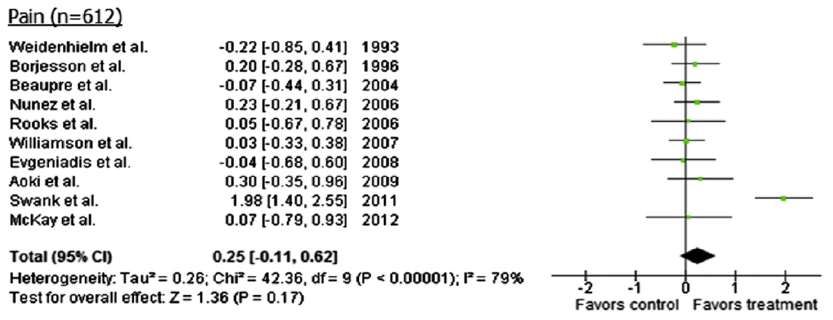
Forest Plot: KR pain reduction

Slide 15
Forest Plot: HR pain reduction

Slide 16
Findings
The results of Swank et al were noticeably different from all others in the knee replacement group (not just in pain scores). This caused significant statistical heterogeneity and suggests that their study was different from the others.
In people waiting for knee or hip replacement surgery there is some evidence of benefit in terms of reduction in pain for those awaiting hip replacement but this was not found in those awaiting knee replacement surgery

Slide 17
Non randomised trials
Results can be considered in a similar manner.
As you will not have a comparison group you need to consider the size of the participant group, the size of the effect of the intervention, and the direction of the effect (improvement or deterioration compared to baseline measures).
You may find it helps to draw a similar diagram.
In a hierarchy of evidence, findings will not be considered to be as strong as those of a RCT.

Slide 18
What if the outcomes are different?
Dichotomous outcomes
Dead/alive
Injured/not injured
Satisfied/not satisfied with the treatment
Indicate the outcome in terms of the proportion of participants that experienced the outcome of interest. (‘risk’ of an event)
Determine if the risk level differs between intervention and control groups

Slide 19
Expressing differences in risk
Absolute risk reduction = difference in risk between intervention and control groups.
Risk for intervention group – risk for control group = ?
Number needed to treat = (inverse of ARR) X100 = 100/ARR = number needed to be treated to stop an adverse outcome in 1 person. A small number suggests the treatment effect is worthwhile.
Relative risk reduction=ARR/risk in control group
95% CI’s=ARR±1/√n_{av}
Notes:
Say for example there are 200 people in hospital after a stroke. 100 receive treatment and 100 are the control group.
What is the risk that they will or will not be able to walk independently after their stroke?
In the group that receive treatment 20 (20%) are not able to walk independently after their stroke.
In the control group 70 (70%) are not able to walk independently.
ARR = 20%-70%= 50% is the difference between the two groups
NNT = 100/50 = 2 people need to be treated to stop an adverse outcome for one person.
RRR = 50/70= 71.5% Treatment would reduce the proportion not able to walk independently by 71.5%
95%CIS= 50%.±1/10 = 50=10=60 and 50-10=40 ARR=50% 95% CI (40,60)
Best represented by a tree plot- horizontal line represents treatment effect with extremes of not beneficial to beneficial
KEEP IN MIND that these figures will never look very impressive when the risk of an event is low in the first place (in the control group). Even the best interventions will not produce clinically worthwhile effects if the risk of the event is low.
ALSO when you think about this in relation to a specific patient consider their specific baseline risk. If they do not have any risk factors then the effect of intervention will be overestimated. If they have significant risk factors the effect of the intervention may be underestimated.

Slide 20
Prognostic Studies
Are the study participants similar to those you see?
Is the follow up long enough to be useful?
What happens if there is no treatment?
What happens if ‘usual treatment’ is provided?
Information from these studies can help inform patients about likely outcomes.
Prognostic studies can also help to scale estimates about prognosis to particular populations.
Survival curves illustrate how risk of experiencing an event changes with time.

Slide 21
Accuracy of a diagnostic test
Are the participants similar to your clients?
Is the skill of the tester similar to yours?
Is the clinical setting similar to yours? (specialist versus generic)
Requires knowledge of true and false positive and negative results to establish sensitivity and specificity of the test.
Sensitivity = probability that those with the condition will test positive
Specificity = probability that those who do not have the condition will test negative
Likelihood ratio = probability that the person with a particular test finding actually has the condition.
Notes:
Sensitivity= true positive/ (true positive and false negative)
Specificity= true negative/ (true negative and false positive)
+ve likelihood ratio = sensitivity (100-specificity) score >3 useful, >10 very useful
-ve likelihood ratio= (100-sensitivity)/specificity, <1 worthwhile, <0.33 useful, <0.1 very useful
Likelihood ratios tell us how much to change our estimate of the probability of a diagnosis based on the test findings.

Slide 22
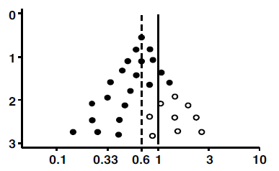
What is a funnel plot?
A funnel plot is a scatter plot of treatment effects against a measure of study size. Usually larger studies will be plotted near the average with smaller studies spread on each side.
A funnel plot is a visual aid for detecting
systematic heterogeneity
or bias. Where no bias is
evident a symmetrical
inverted funnel shape
results.

Slide 23
Summarising findings from qualitative studies
Qualitative data is about validity (reporting truth) rather than reliability (repeatability). Numbers or ‘vote counting’ are irrelevant.
Qualitative results should form a narrative or story that explains accurately the issue(s) being studied.
The results are an interpretation of the data, often grouped into themes, patterns or categories. The use of more than one researcher in this interpretation can improve the rigour of the findings. The use of quotations from the data will assist in understanding the data interpretation.
Pulling findings together from qualitative studies requires careful reading and interpretation of each study. Similar issues may have been grouped but given a slightly different theme name. Alternative explanations may be described that are related to the sample rather than the questions asked.

Slide 24
Publishing your Systematic Review
The point of these workshops was to give you an EBP framework to assist in clinical practice.
If you have worked systematically through your search strategy, finding all the relevant papers and thoughtfully summarising the findings you have the makings of a good publishable systematic review.

Slide 25
Changing Practice 1
Before you alter your practice, based on the results of a literature review, check the other aspects of EBP:
Do you have the experience and expertise?
Do you need new skills and training, or to revise or upgrade some skills?
What are the needs and preferences of the individual client?
Is the change appropriate in the context or environment of your practice?

Slide 26
Changing Practice 2
In a team setting changing practice is not as easy as implementing new procedures.
There needs to be:
a recognition of the need for change and
Preparation – this may include development of new policies and procedures, staff training in new skills, changing documentation methods…
Testing and troubleshooting before full implementation

